Slide 2

Natural Language Processing
BERT
Mamatha.H.R
Department of Computer Science and Engineering

Slide 3

NATURAL LANGUAGE PROCESSING
Disclaimer
These slides are majorly prepared from
https://www.analyticsvidhya.com/blog/2019/06/understanding-transformers-nlp-state-of-the-art-models/
https://www.searchenginejournal.com/bert-explained-what-you-need-to-know-about-googles-new-algorithm/337247/#close

Slide 4
NATURAL LANGUAGE PROCESSING
Bidirectional Transformer Encoders
Bidirectional Transformers consist of two separate Transformer models: one that processes the input sequence from left to right, and one that processes it from right to left.
Example: BERT

Slide 5

NATURAL LANGUAGE PROCESSING
BERT: Overview
Transfer Learning??
Transfer learning is a machine learning method where a model developed for a task is reused as the starting point for a model on a second task.
It is a popular approach in deep learning where pre-trained models are used as the starting point , given the vast compute and time resources required to develop neural network models on these problems and from the huge jumps in skill that they provide on related problems.

Slide 6
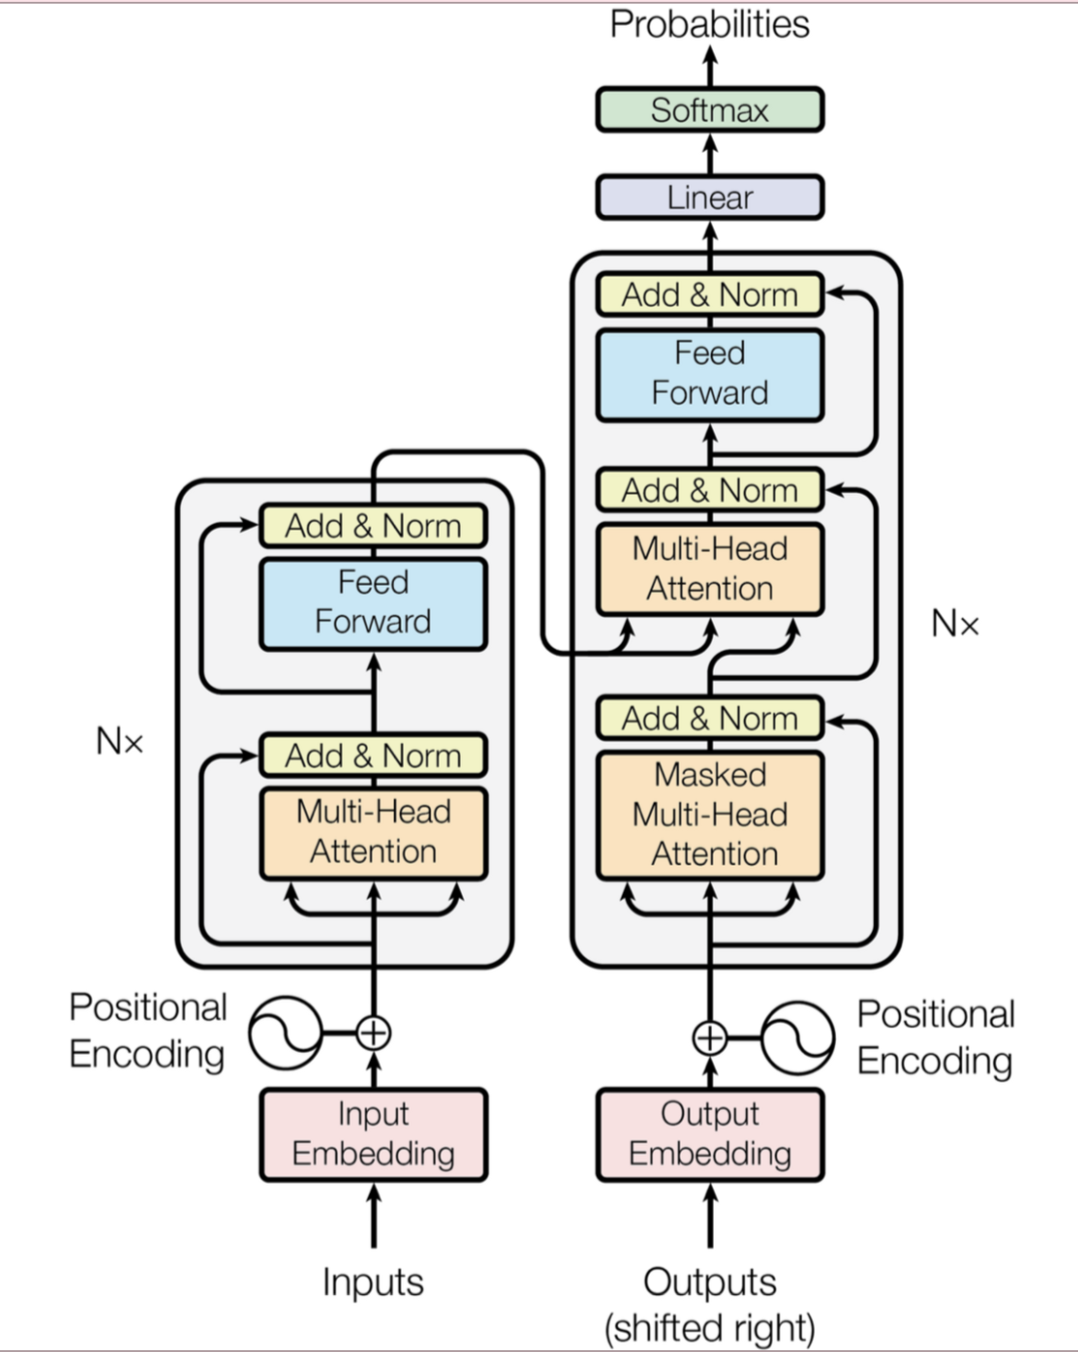

NATURAL LANGUAGE PROCESSING
Transformer - Recap
Both Encoder and Decoder are composed of modules that can be stacked on top of each other multiple times, which is described by Nx in the figure.
The modules consist mainly of
Multi-Head Attention and
Feed Forward layers.
The inputs and outputs (target sentences) are first embedded into an n-dimensional space (since we cannot use strings directly.)
Another important part of the model is the positional encoding of the different words.
As there are no recurrent networks that can remember how sequences are fed into a model, there is a need to somehow give every word/part in the sequence a relative position since a sequence depends on the order of its elements.
These positions are added to the embedded representation (n-dimensional vector) of each word.
Encoder Module
Decoder Module

Slide 7
NATURAL LANGUAGE PROCESSING
BERT: Overview
It’s more popularly known as a Google search algorithm ingredient /tool/framework called Google BERT which aims to
help Search better understand the nuance and context of words in searches and
better match those queries with helpful results.
BERT is also an open-source research project and academic paper. First published in October 2018 as BERT: Pre-training of Deep Bidirectional Transformers for Language Understanding, the paper was authored by Jacob Devlin, Ming-Wei Chang, Kenton Lee, Kristina Toutanova.
BERT is a natural language processing NLP framework that Google produced and then open-sourced and it has dramatically accelerated natural language understanding NLU more than anything and Google’s move to open source BERT has probably changed natural language processing forever.

Slide 8
NATURAL LANGUAGE PROCESSING
BERT: Overview
It has been pre-trained on a lot of words – and on the whole of the English Wikipedia 2,500 million words.
While BERT has been
pre-trained on Wikipedia,
it is fine-tuned on questions and answers datasets.
Researchers also compete over Natural Language Understanding with SQuAD (Stanford Question Answering Dataset).
BERT now even beats the human reasoning benchmark on SQuAD.

Slide 9
NATURAL LANGUAGE PROCESSING
BERT
Lots of the major AI companies are also building BERT versions:
Microsoft extends on BERT with MT-DNN (Multi-Task Deep Neural Network).
RoBERTa from Facebook.
SuperGLUE Benchmark was created because the original GLUE Benchmark became too easy.

Slide 10
NATURAL LANGUAGE PROCESSING
BERT: What Challenges Does BERT Help to Solve?
There are things that humans understand easily that machines don’t really understand at all including search engines.
The Problem with Words
The problem with words is that they’re everywhere. More and more content is out there.
Words are problematic because plenty of them are ambiguous, polysemous, and synonymous.
BERT is designed to help solve ambiguous sentences and phrases that are made up of lots and lots of words with multiple meanings.

Slide 11
NATURAL LANGUAGE PROCESSING
BERT: What Challenges Does BERT Help to Solve?
Ambiguity & Polysemy
Almost every other word in the English language has multiple meanings. In spoken word, it is even worse because of homophones and prosody.
For instance, “four candles” and “fork handles” for those with an English accent. Another example: comedians’ jokes are mostly based on the play on words because words are very easy to misinterpret.
It’s not very challenging for us because we have common sense and context so we can understand all the other words that surround the context of the situation or the conversation – but search engines and machines don’t.
This does not bode well for conversational search into the future.

Slide 12
NATURAL LANGUAGE PROCESSING
BERT
Word’s Context
The meaning of a word is its use in a language.” – Ludwig Wittgenstein, Philosopher, 1953
A word has no meaning unless it’s used in a particular context.
The meaning of a word changes literally as a sentence develops due to the multiple parts of speech a word could be in a given context.

Slide 13
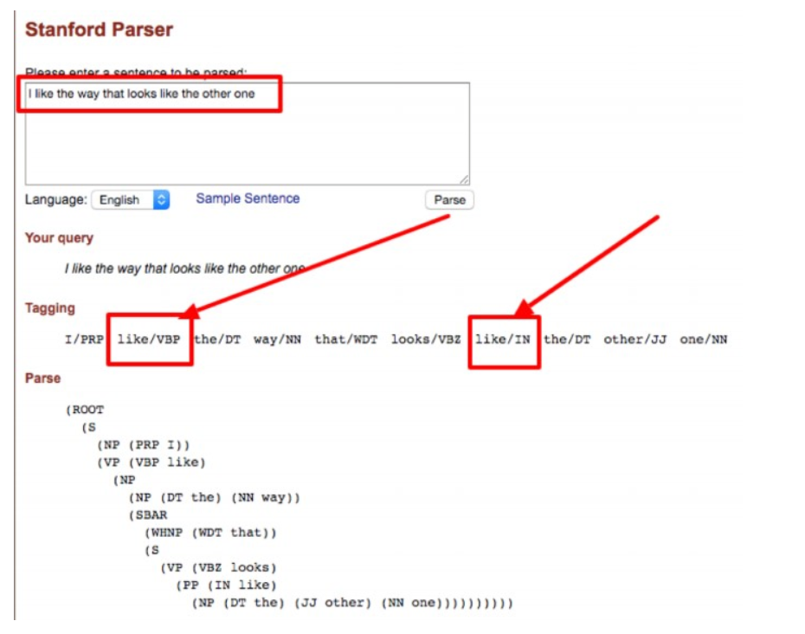
NATURAL LANGUAGE PROCESSING
BERT

Slide 14
NATURAL LANGUAGE PROCESSING
BERT
Eg.
“I like the way that looks like the other one.”
By Stanford Part-of-Speech Tagger , “like” is considered to be two separate parts of speech (POS).
The word “like” may be used as different parts of speech including verb, noun, and adjective.
So literally, the word “like” has no meaning because it can mean whatever surrounds it.
The context of “like” changes according to the meanings of the words that surround it.
The longer the sentence is, the harder it is to keep track of all the different parts of speech within the sentence.

Slide 15
NATURAL LANGUAGE PROCESSING
How Can Search Engines Fill in the Gaps Between Named Entities?
Natural Language Disambiguation
“You shall know a word by the company it keeps.” – John Rupert Firth, Linguist, 1957
Words that live together are strongly connected:
Co-occurrence.
Co-occurrence provides context.
Co-occurrence changes a word’s meaning.
Words that share similar neighbors are also strongly connected.
Similarity and relatedness.

Slide 16
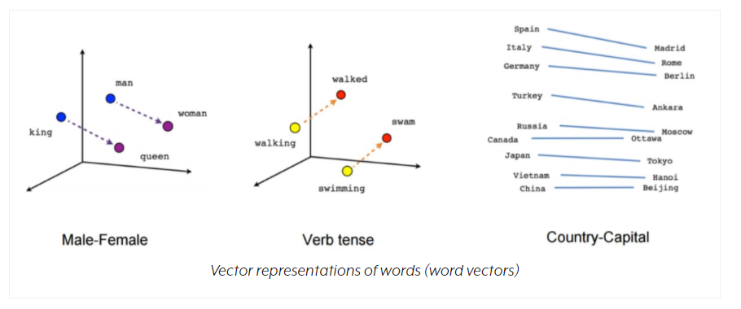
NATURAL LANGUAGE PROCESSING
BERT
Language Models are trained on very large text corpora or collections text to learn distributional similarity and build vector space models for word embeddings.

Slide 17
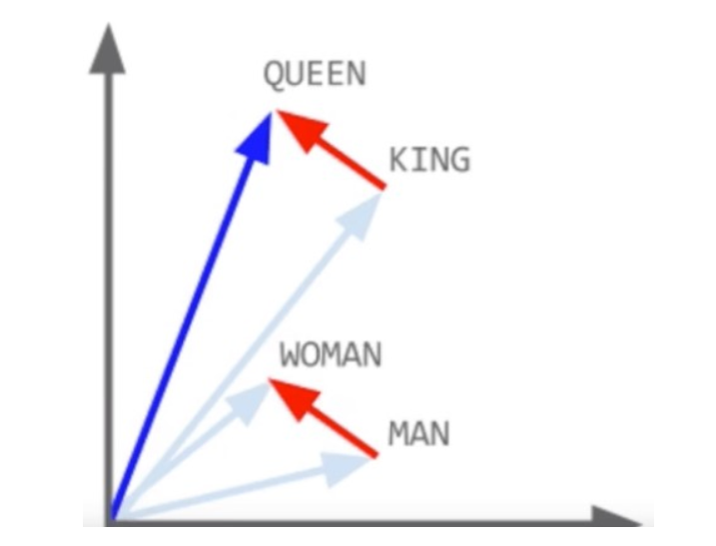
NATURAL LANGUAGE PROCESSING
BERT
The NLP models learn the weights of the similarity and relatedness distances.
But even if the entity (thing) itself is understood, one needs to understand word’s context

Slide 18
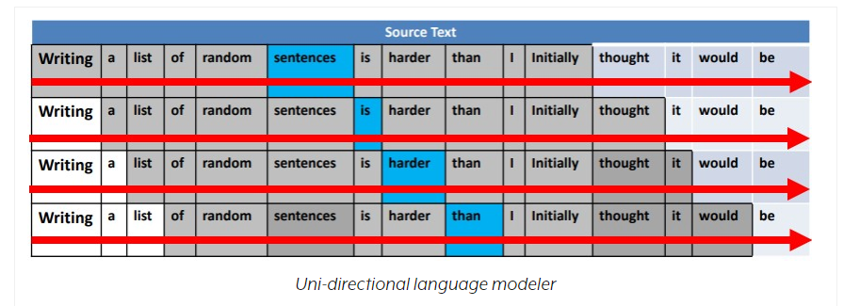
NATURAL LANGUAGE PROCESSING
How BERT Works
B: Bi-directional
Previously all language models (i.e., Skip-gram and Continuous Bag of Words) were unidirectional so they could only move the context window in one direction – a moving window of “n” words (either left or right of a target word) to understand word’s context.

Slide 19
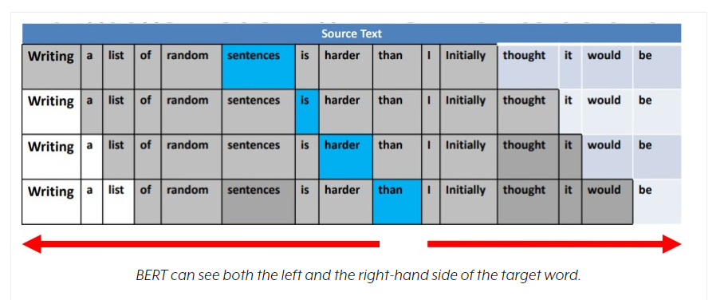
NATURAL LANGUAGE PROCESSING
BERT
So far language modelers were unidirectional.
Can traverse over the word’s context window from LtoR or RtoL. Only in one direction, but not both at the same time.
BERT can see the WHOLE sentence on either side of a word (contextual language modeling) and all of the words almost at once.

Slide 20
NATURAL LANGUAGE PROCESSING
BERT
ER: Encoder Representations
What gets encoded is decoded. It’s an in-and-out mechanism.

Slide 21
NATURAL LANGUAGE PROCESSING
BERT
T: Transformers
Transformer is behind the recent NLP developments, including Google’s BERT
BERT uses “transformers” and “masked language modeling”.
From the super-efficient ULMFiT framework to Google’s BERT, NLP is truly in the midst of a golden era.

Slide 22
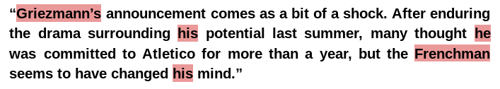
NATURAL LANGUAGE PROCESSING
BERT
One of the big issues with natural language understanding in the past has been not being able to understand in what context a word is referring to. For example:
The highlighted words refer to the same person – Griezmann, a popular football player. Simple for us to understand.
But way too difficult for a machine to understand.
Pronouns, for instance. It’s very easy to lose track of who’s somebody’s talking about in a conversation. Even humans can struggle to keep track of who somebody’s being referred to in a conversation all the time.

Slide 23
NATURAL LANGUAGE PROCESSING
BERT
Capturing such relationships and sequence of words in sentences is vital for a machine to understand a natural language. This is where the Transformer concept plays a major role.

Slide 24
NATURAL LANGUAGE PROCESSING
BERT
So transformers’ attention part actually focuses on the pronouns and all the words’ meanings that go together about in any given context.
Masked language modeling(MLM) stops the target word from seeing itself. The mask is needed because it prevents the word that’s under focus from actually seeing itself.
When the mask is in place, BERT just guesses at what the missing word is. It’s part of the fine-tuning process as well.

Slide 25


NATURAL LANGUAGE PROCESSING
BERT
The Transformer in NLP is a novel architecture that aims to solve sequence-to-sequence tasks while handling long-range dependencies with ease.
(The Transformer was proposed in the paper Attention Is All You Need . )
Vaswani A, Shazeer N, Parmar N, Uszkoreit J, Jones L, Gomez AN, Kaiser L, Polosukhin I. Attention is all you need. arXiv preprint arXiv:1706.03762. 2017 Jun 12.

Slide 26
NATURAL LANGUAGE PROCESSING
Self Attention: Limitations
But it comes with its own share of limitations:
Attention can only deal with fixed-length text strings.
The text has to be split into a certain number of segments or chunks before being fed into the system as input.
This chunking of text causes context fragmentation.
For example, if a sentence is split from the middle, then a significant amount of context is lost. In other words, the text is split without respecting the sentence or any other semantic boundary.

Slide 27
NATURAL LANGUAGE PROCESSING
What Types of Natural Language Tasks Does BERT Help With?
BERT helps in:
Named entity determination.
Textual entailment next sentence prediction.
Coreference resolution.
Question answering.
Word sense disambiguation.
Automatic summarization.
Polysemy resolution.
BERT advanced the state-of-the-art (SOTA) benchmarks across 11 NLP tasks.

Slide 28
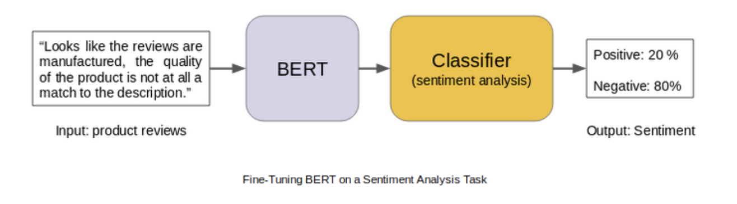
NATURAL LANGUAGE PROCESSING
BERT ( Bidirectional Encoder Representations from Tranformers)
Transfer learning has been very relevant in the field of computer vision.
Similarly, Language model pre-training has been quite effective for improving many natural language processing tasks.
The BERT framework, uses pre-training and fine-tuning to create state-of-the-art models for a wide range of tasks. These tasks include question answering systems, sentiment analysis, and language inference.
BERT Implementation:
Pre-training
Fine Tuning

Slide 29
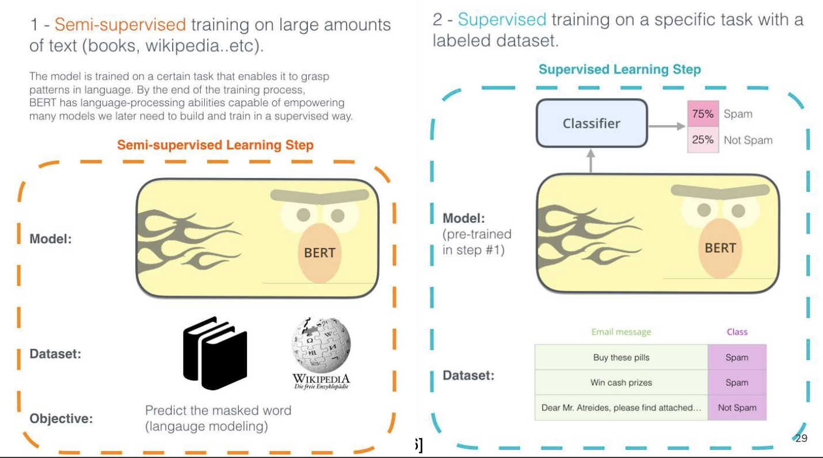
NATURAL LANGUAGE PROCESSING
BERT
BERT almost have the same model architecture across different tasks with small changes between the pre-trained architecture and the final downstream architecture

Slide 30
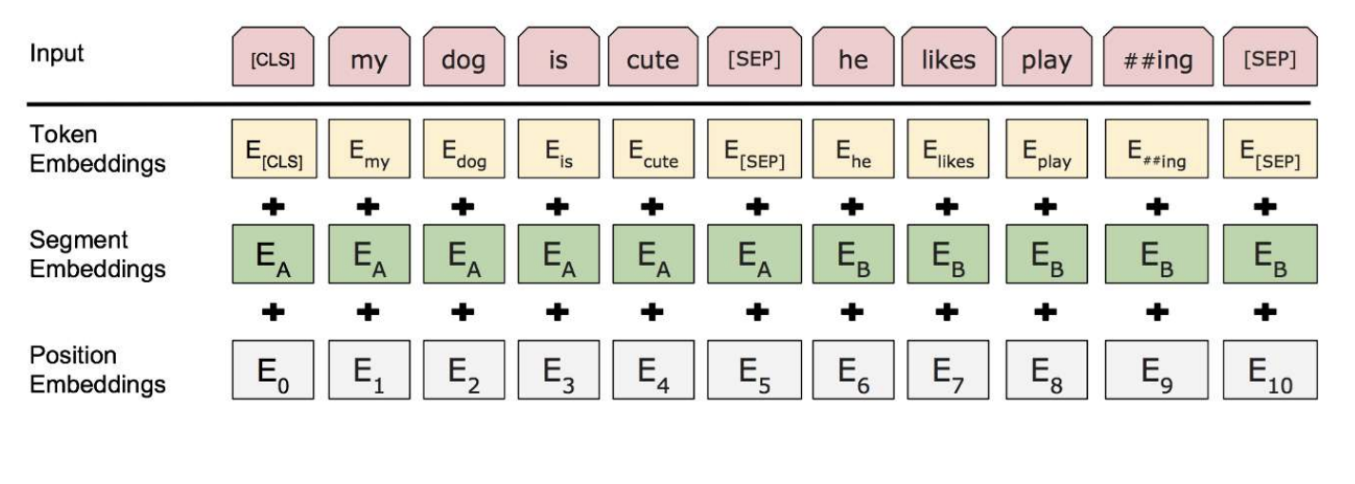
NATURAL LANGUAGE PROCESSING
Model Input Output Representation
The first token in each sequence is always a [CLS] token that is used in classification.
● Separating Sentences apart can be done in two steps:
○ Separate between sentences using [SEP] token,
○ Adding a learned embedding to each token in order to state which sentence it belongs to.
Each token is represented by summing the corresponding token, segment and position embedding as seen in the figure
https://medium.com/@_init_/why-bert-has-3-embedding-layers-and-their-implementation-details-9c261108e28a

Slide 31
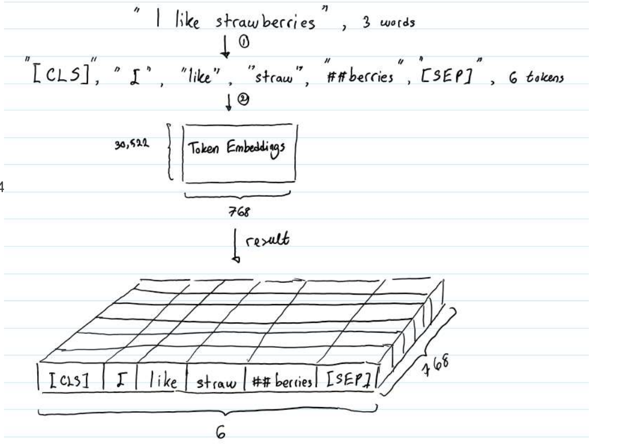
NATURAL LANGUAGE PROCESSING
BERT
● BERT input can be represented by either a single sentence, or pair of sentences (like Question Answering).
● BERT use WordPiece embeddings with 30,000 token vocabulary.
[CLS] is the reserved token to represent the start of sequence while “SEP” separate segment (or sentence).
In BERT, each word is represented as a 768-dimensional vector.
Here the matrix of shape (6, 768) or a tensor of shape (1, 6, 768)

Slide 32
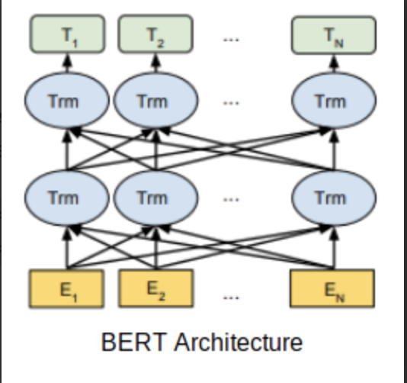
NATURAL LANGUAGE PROCESSING
BERT Architecture
BERT uses a multi-layer bidirectional Transformer encoder.
Its self-attention layer performs self-attention in both directions.
Google has released two variants of the model:
BERT Base: Number of Transformers layers = 12, Total Parameters = 110M
BERT Large: Number of Transformers layers = 24, Total Parameters = 340M

Slide 33
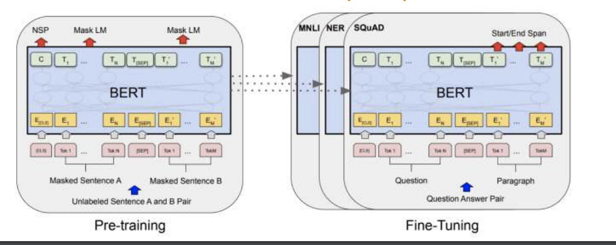
NATURAL LANGUAGE PROCESSING
BERT Architecture
BERT uses bidirectionality by pre-training on a couple of unsupervised tasks —
Masked Language Model
Next Sentence Prediction

Slide 34
NATURAL LANGUAGE PROCESSING
Masked LM
The masked language model randomly masks some of the tokens from the input, and the objective is to predict the original vocabulary id of the masked word based only on its context.
The MLM allows the representation to fuse the left and the right context, which allows to pre-train a deep bidirectional Transformer.
The Google AI researchers masked 15% of the words in each sequence at random for predicting these masked words.
So, the researchers used the below technique:
80% of the time the words were replaced with the masked token [MASK]
10% of the time the words were replaced with random words
10% of the time the words were left unchanged

Slide 35
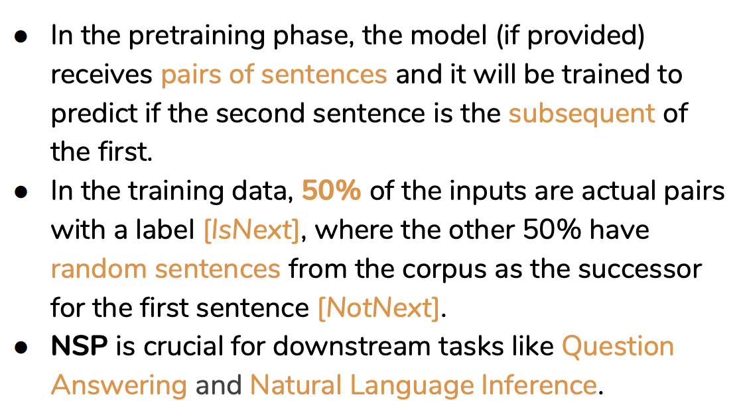
NATURAL LANGUAGE PROCESSING
Next Sentence Prediction

Slide 36
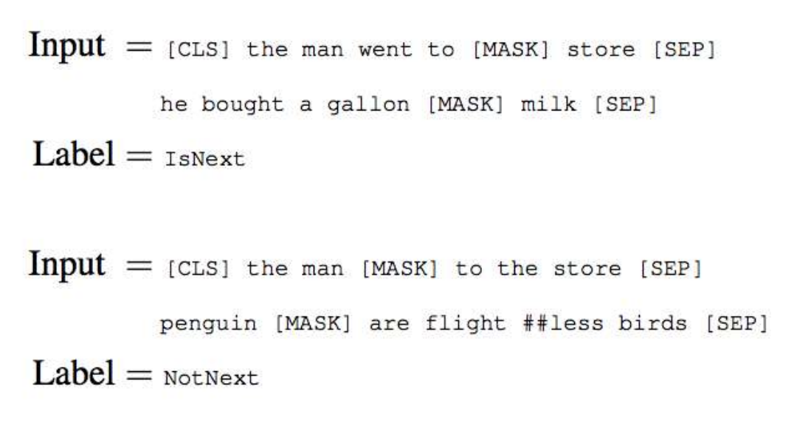
NATURAL LANGUAGE PROCESSING
Next Sentence Prediction

Slide 37
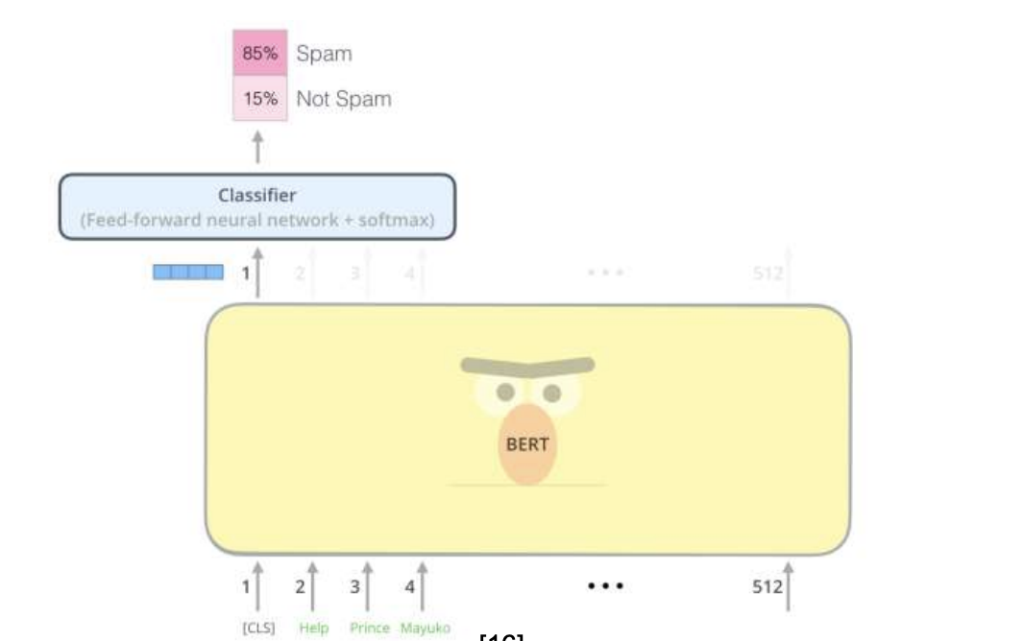
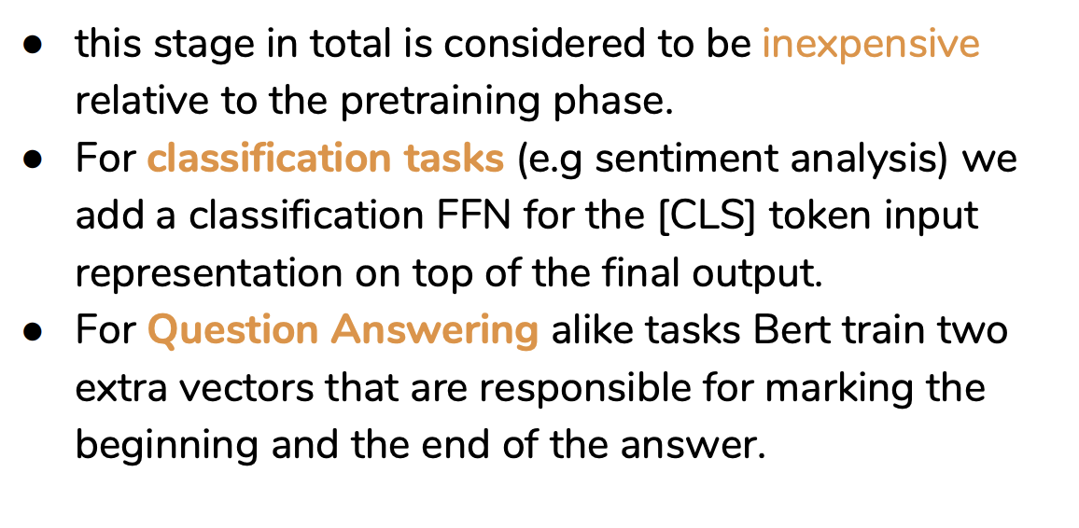
NATURAL LANGUAGE PROCESSING
Fine-Tuning BERT

Slide 38
NATURAL LANGUAGE PROCESSING
Major Contributions
Bert major contribution was in
adding more generalization to existing Transfer Learning methods by using bidirectional architecture.
Bert model also added more contribution to the field. Fine-tuning Bert model can tackle a lot of NLP tasks.

Slide 39
NATURAL LANGUAGE PROCESSING
Course References
Text Book:
1. “Introduction to Natural Language Processing”, Jacob Eisenstein, MIT Press, Adaptive computation and Machine Learning series, 18th October, 2019.
The open source softcopy is available at githubhttps://github.com/jacobeisenstein/gt-nlp class/blob/master/notes/eisenstein-nlp-notes.pdf.
Reference Books:
1: “Speech and Natural Language Processing”, Daniel Jurafsky and James H. Martin, 2nd edition paperback,2013.
The more up to date 3rd edition draft is available at http://web.stanford.edu/~jurafsky/slp3/

Slide 40
Natural Language Processing
Comparison BERT, GPT, ELMO ULMFit
Mamatha.H.R
Department of Computer Science and Engineering

Slide 41
NATURAL LANGUAGE PROCESSING
Disclaimer
These slides are largely prepared from
https://noecasas.com/files/slides/contextual_representations.pdf
https://lilianweng.github.io/lil-log/2019/01/31/generalized-language-models.html

Slide 42
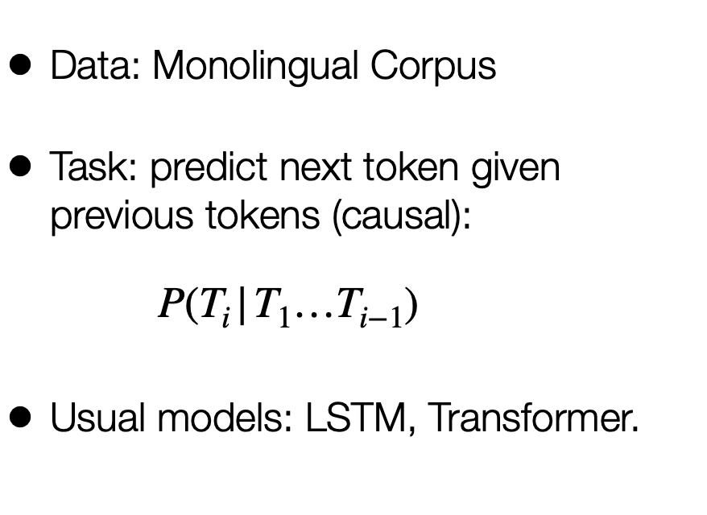
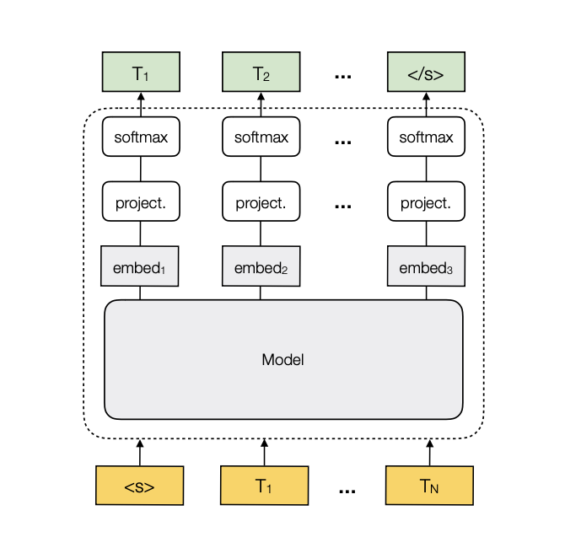
NATURAL LANGUAGE PROCESSING
Language Modeling: Background

Slide 43
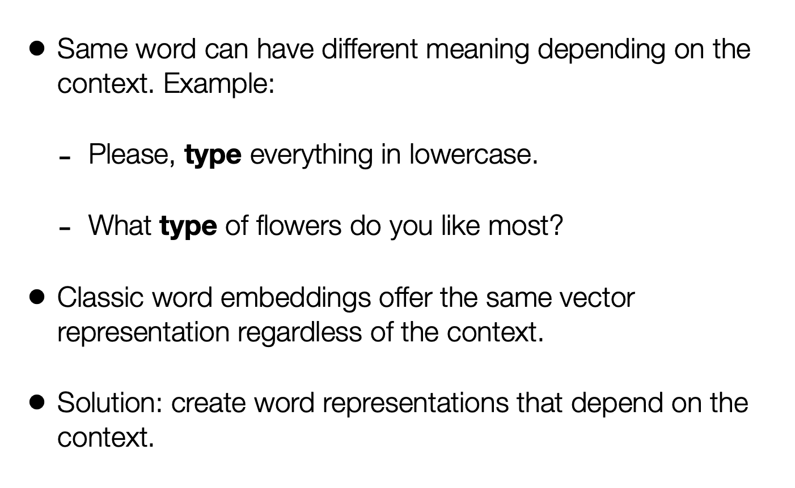
NATURAL LANGUAGE PROCESSING
Contextual Embeddings

Slide 44
NATURAL LANGUAGE PROCESSING
Research Papers for these Models
ULMfit
Universal Language Model Fine-tuning for Text Classification Howard and Ruder (fast.ai)
ELMo
Deep contextualized word representations Peters et al. (AllenNLP)
OpenAI GPT
Improving Language Understanding by Generative Pre-Training Radford et al.(OpenAI)
BERT
BERT: Pre-training of Deep Bidirectional Transformers for Language Understanding Devlin et al. (Google)

Slide 45
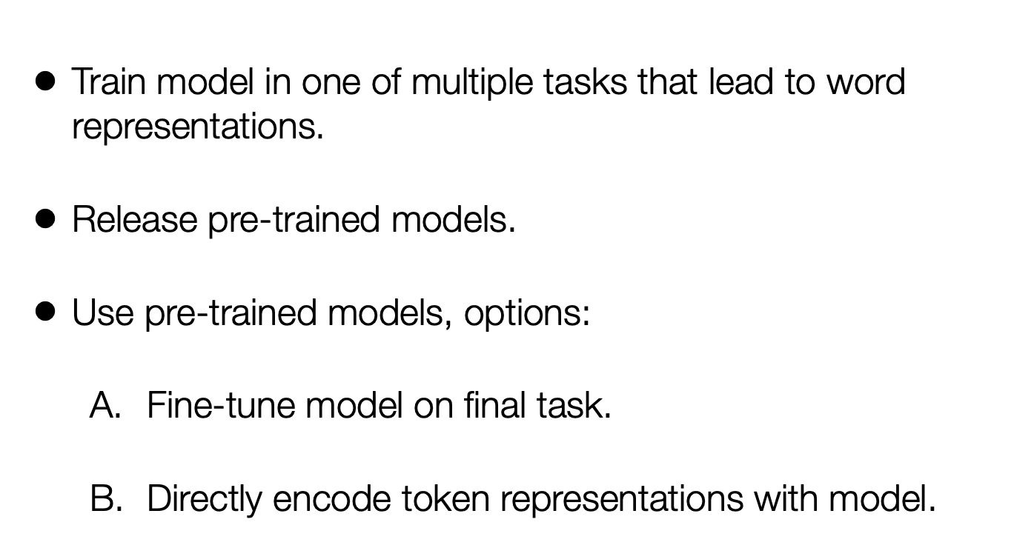
NATURAL LANGUAGE PROCESSING
Overview

Slide 46
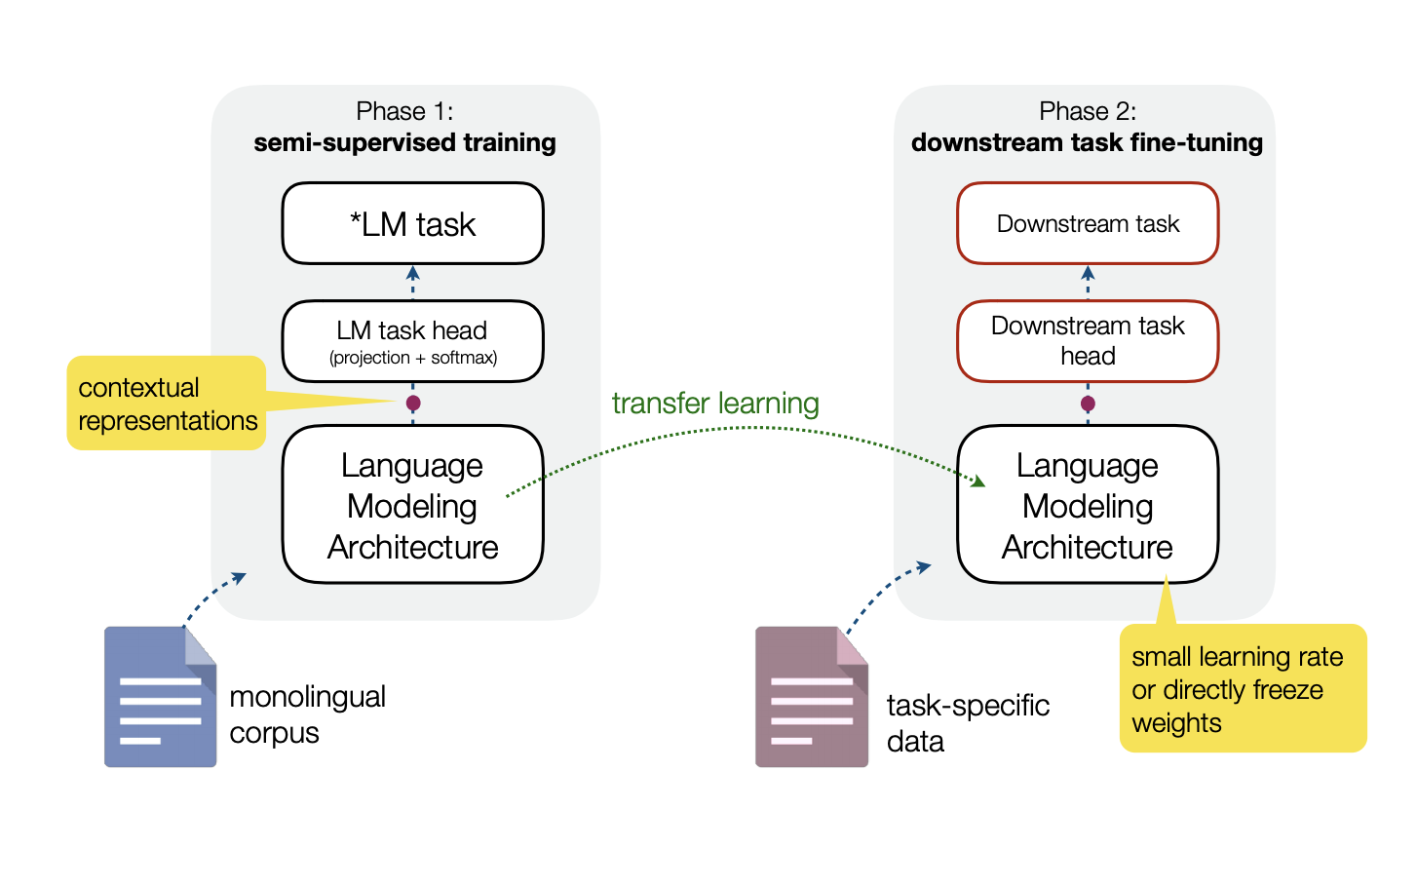
NATURAL LANGUAGE PROCESSING
Overview

Slide 47
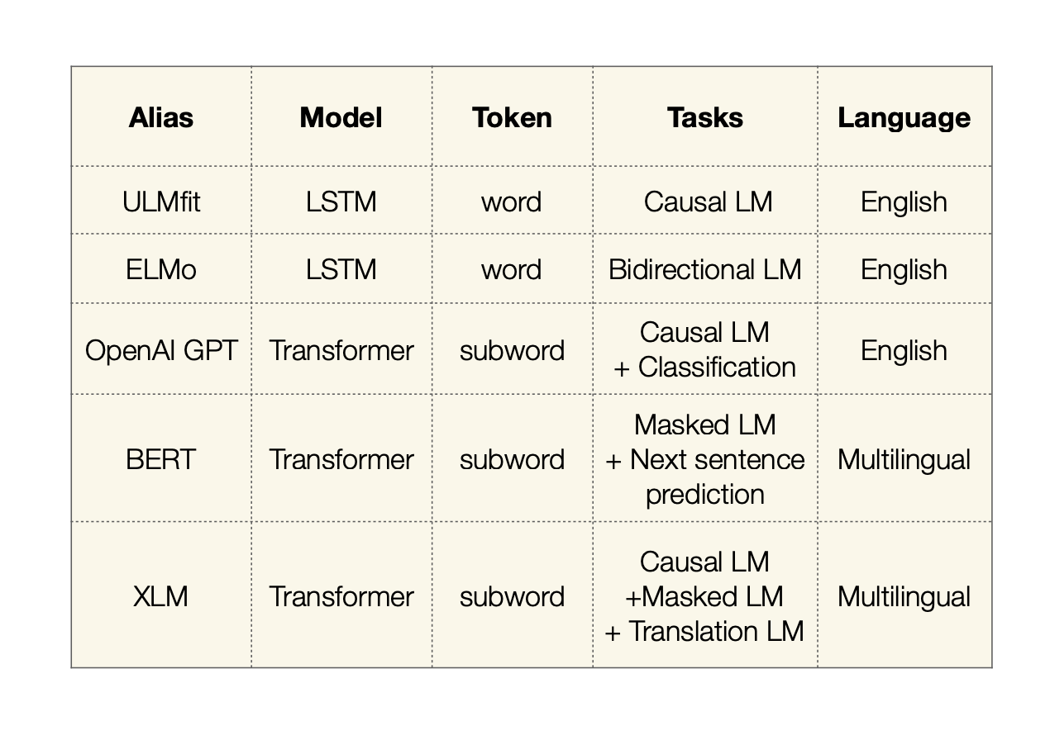
NATURAL LANGUAGE PROCESSING
Differences

Slide 48
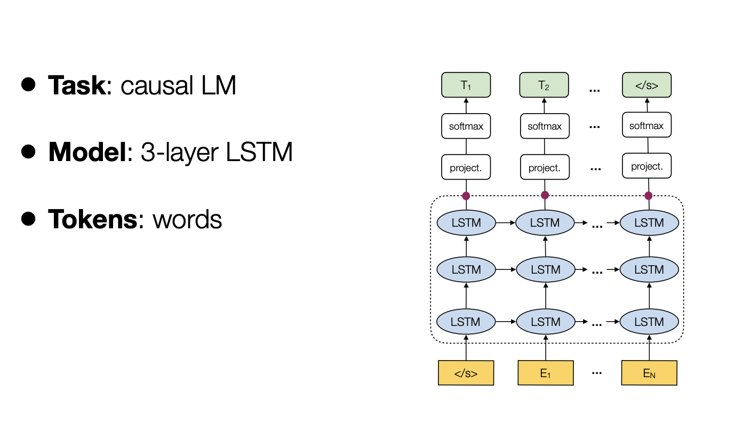
NATURAL LANGUAGE PROCESSING
ULMFit
The idea of using generative pretrained LM + task-specific fine-tuning was first explored in ULMFiT (Howard & Ruder, 2018), directly motivated by the success of using ImageNet pre-training for computer vision tasks.

Slide 49
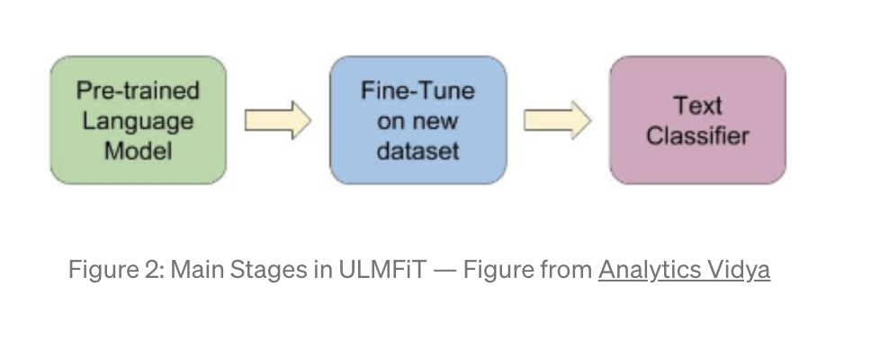
NATURAL LANGUAGE PROCESSING
ULMFit
ULMFiT follows three steps to achieve good transfer learning results on downstream language classification tasks:
1) General LM pre-training: on Wikipedia text.
2) Target task LM fine-tuning: ULMFiT proposed two training techniques for stabilizing the fine-tuning process

Slide 50
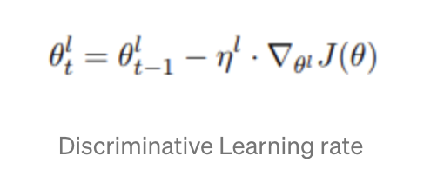
NATURAL LANGUAGE PROCESSING
ULMFit
2) Target task LM fine-tuning: ULMFiT proposed two training techniques for stabilizing the fine-tuning process
A) Discriminative fine-tuning is motivated by the fact that different layers of LM capture different types of information. As different layers grasp different information, author suggest to fine-tune each layer to a different extent.
In discriminative fine-tuning, we use θ1, θ2,… θL instead of singel θ value for respective L layers.
Downstream tasks is what the field calls those supervised-learning tasks that utilize a pre-trained model or component

Slide 51
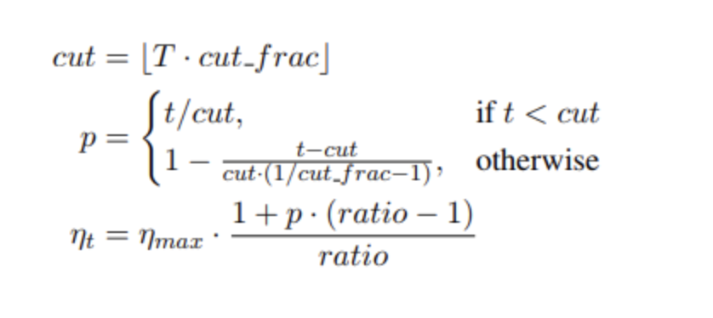
NATURAL LANGUAGE PROCESSING
ULMFit
B) Slanted triangular learning rates (STLR) refer to a special learning rate scheduling that first linearly increases the learning rate and then linearly decays it.
In STLR, authors suggest to increase the learning rate linearly and decay it in the following manner.
T is number of training iterations
cut is the iteration where switch from increasing to decreasing the LR happens
cut_frac is the fraction of iterations for which LR is increased
for t < cut, p is the number of iterations the LR has increased upon the total number of increasing iterations and,
for t >= cut, p is the total number of iterations the LR has decreased upon the total number of decreasing iterations.
p is the fraction of the number of iterations we have increased or will decrease the LR respectively
ratio specifies how much smaller the lowest LR is from the maximum LR η_{max}
η_{t} is the learning rate at iteration t

Slide 52
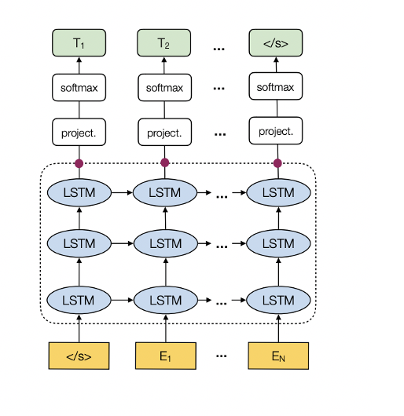
NATURAL LANGUAGE PROCESSING
ULMFit
3) Target task classifier fine-tuning: The pretrained LM is augmented with two standard feed-forward layers , one with ReLU activation and other with softmax activation at the end to predict a target label distribution.
Some Additional Steps which improve the Model Further
Concat pooling extracts max-pooling and mean-pooling over the history of hidden states and concatenates them with the final hidden state.
Gradual unfreezing helps to avoid catastrophic forgetting by gradually unfreezing the model layers starting from the last one.

Slide 53
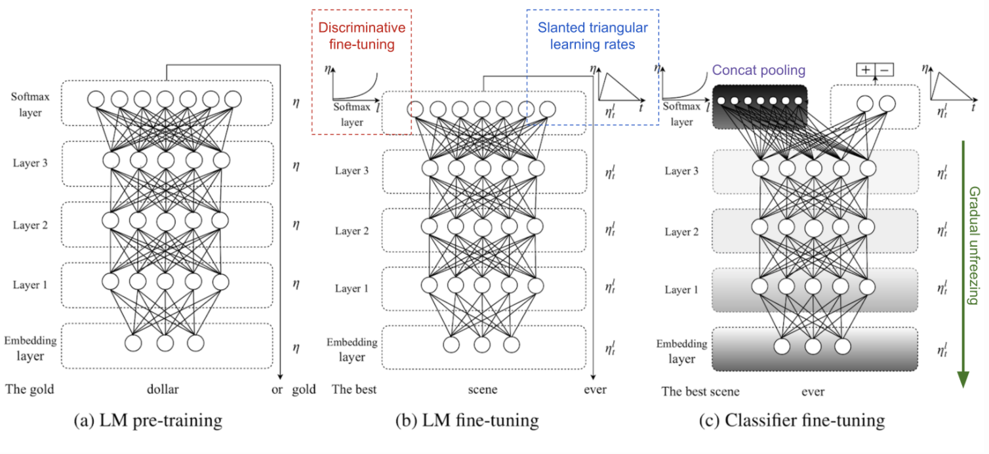
NATURAL LANGUAGE PROCESSING
Three training stages of ULMFiT

Slide 54
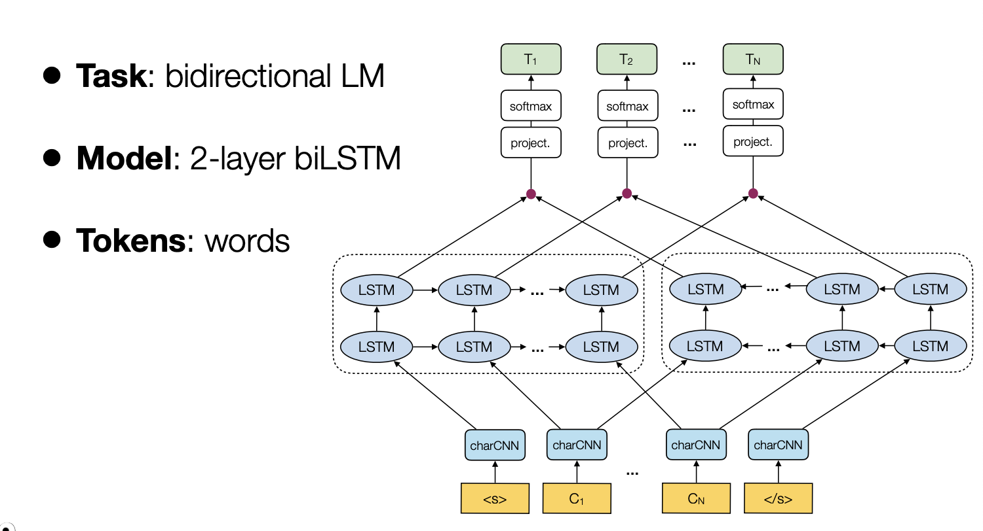
NATURAL LANGUAGE PROCESSING
ELMO

Slide 55
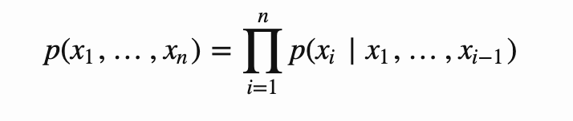
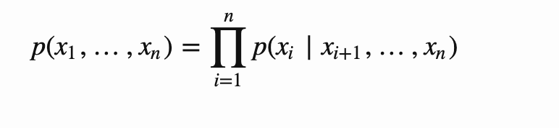
NATURAL LANGUAGE PROCESSING
ELMO
ELMo, short for Embeddings from Language Model (Peters, et al, 2018) learns contextualized word representation by pre-training a language model in an unsupervised way.
The bidirectional Language Model (biLM) is the foundation for ELMo.
While the input is a sequence of n tokens, (x1,…,xn) the language model learns to predict the probability of next token given the history.
In the forward pass, the history contains words before the target token,
In the backward pass, the history contains words after the target token,

Slide 56
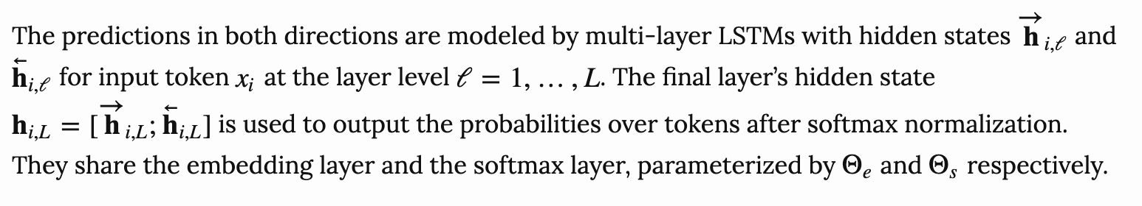
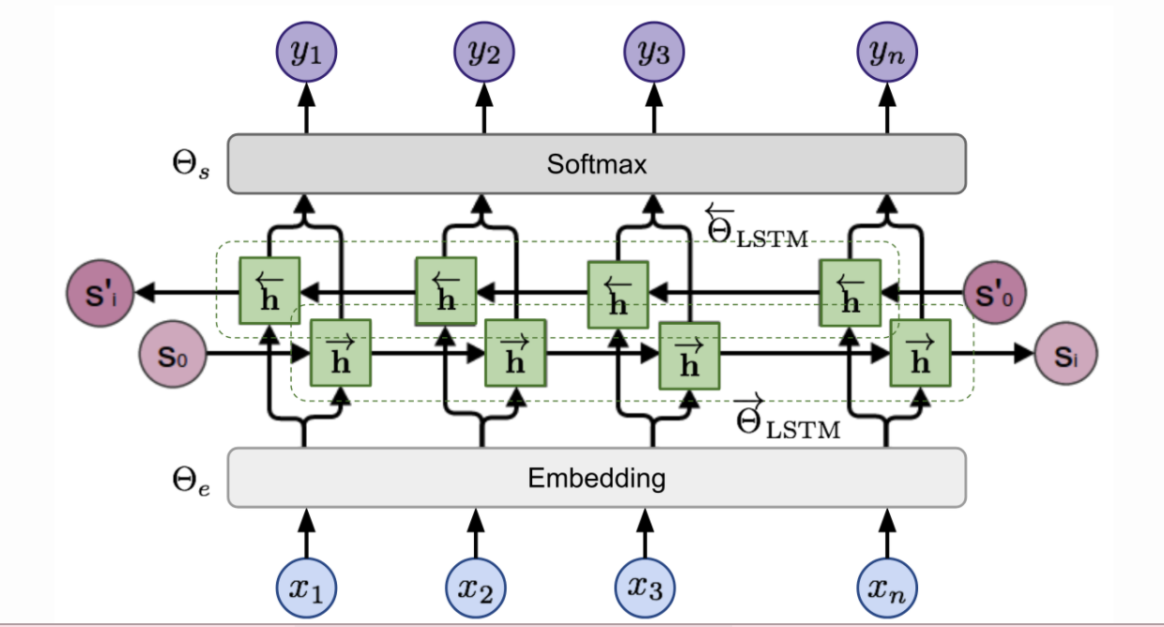
NATURAL LANGUAGE PROCESSING
ELMO

Slide 57
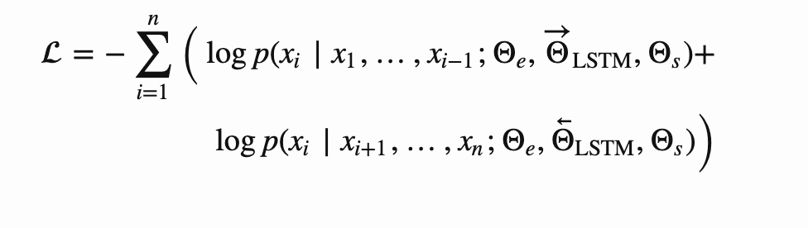
NATURAL LANGUAGE PROCESSING
ELMO
The model is trained to minimize the negative log likelihood (= maximize the log likelihood for true words) in both directions:
On top of a L-layer biLM, ELMo stacks all the hidden states across layers together by learning a task-specific linear combination. The weights, s^{task}, in the linear combination are learned for each end task and normalized by softmax.
Summary: The language model pre-training is unsupervised and theoretically the pre-training can be scaled up as much as possible since the unlabeled text corpora are abundant.

Slide 58
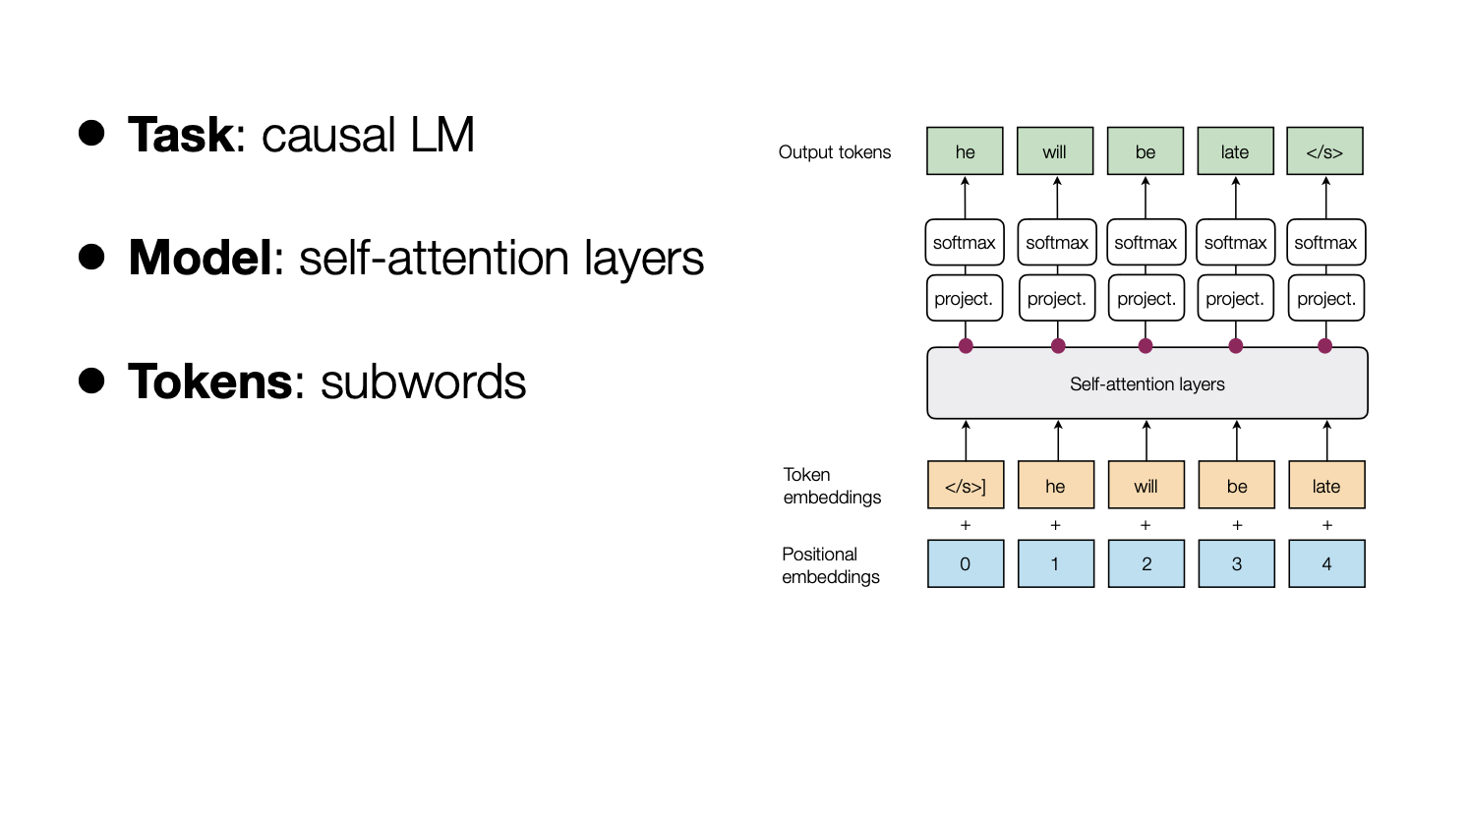
NATURAL LANGUAGE PROCESSING
GPT(Generative Pre-training Transformer)

Slide 59
NATURAL LANGUAGE PROCESSING
GPT(Generative Pre-training Transformer)
Following the similar idea of ELMo, OpenAI GPT (Radford et al., 2018), expands the unsupervised language model to a much larger scale by training on a giant collection of free text corpora.
Despite of the similarity, GPT has two major differences from ELMo.
The model architectures are different: ELMo uses a shallow concatenation of independently trained left-to-right and right-to-left multi-layer LSTMs, while GPT is a multi-layer transformer decoder.
The use of contextualized embeddings in downstream tasks are different: ELMo feeds embeddings into models customized for specific tasks as additional features, while GPT fine-tunes the same base model for all end tasks.

Slide 60
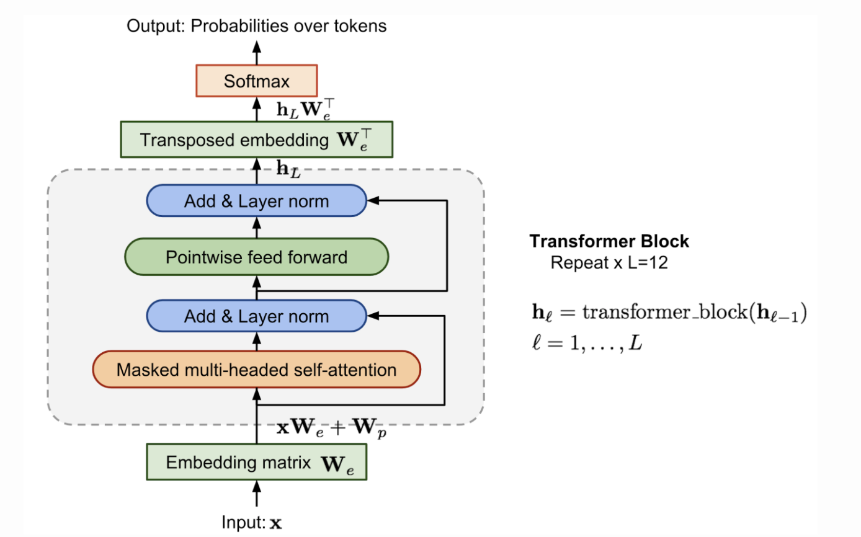
NATURAL LANGUAGE PROCESSING
GPT(Generative Pre-training Transformer)
Compared to the original transformer architecture, the transformer decoder model discards the encoder part, so there is only one single input sentence rather than two separate source and target sequences.
This model applies multiple transformer blocks over the embeddings of input sequences.
Each block contains a masked multi-headed self-attention layer and a pointwise feed-forward layer.
The final output produces a distribution over target tokens after softmax normalization.

Slide 61
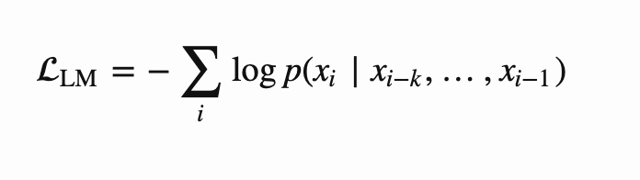
NATURAL LANGUAGE PROCESSING
GPT(Generative Pre-training Transformer)
The loss is the negative log-likelihood, same as ELMo, but without backward computation.
Let’s say, the context window of the size k is located before the target word and the loss would be:

Slide 62
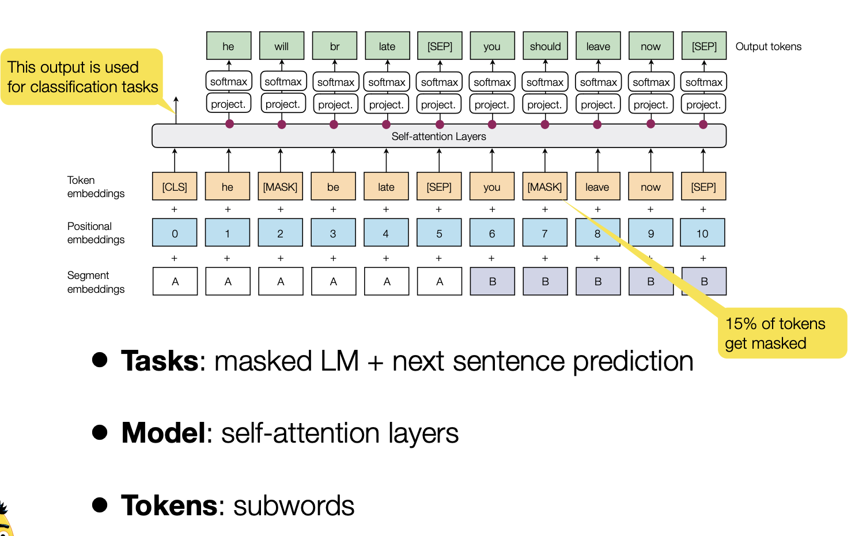
NATURAL LANGUAGE PROCESSING
BERT

Slide 63
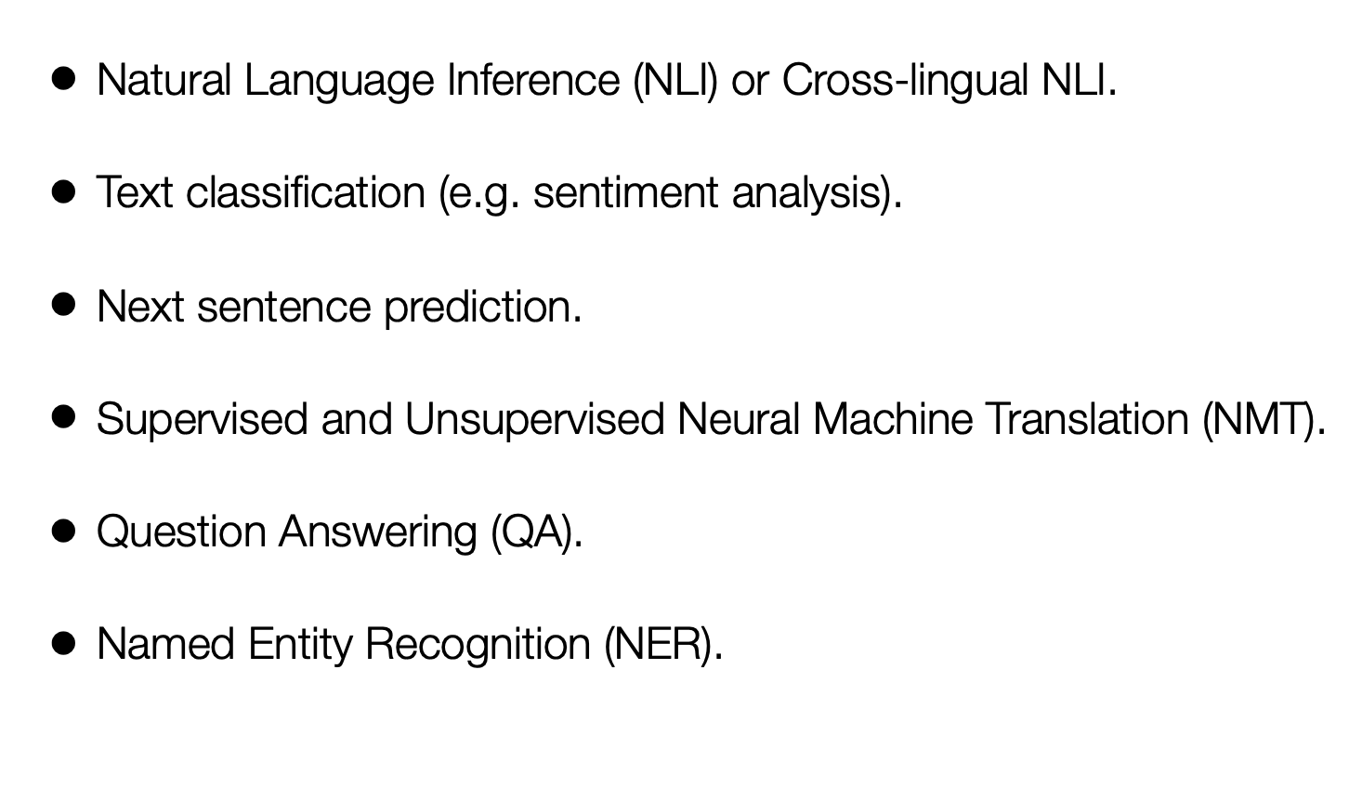
NATURAL LANGUAGE PROCESSING
Downstream Tasks

Slide 64
NATURAL LANGUAGE PROCESSING
Course References
Text Book:
1. “Introduction to Natural Language Processing”, Jacob Eisenstein, MIT Press, Adaptive computation and Machine Learning series, 18th October, 2019.
The open source softcopy is available at githubhttps://github.com/jacobeisenstein/gt-nlp class/blob/master/notes/eisenstein-nlp-notes.pdf.
Reference Books:
1: “Speech and Natural Language Processing”, Daniel Jurafsky and James H. Martin, 2nd edition paperback,2013.
The more up to date 3rd edition draft is available at http://web.stanford.edu/~jurafsky/slp3/

